Slide 1
WiSense Academy
Nicodemus Mbacham | Developer
String variables and asking a user to enter a value
input
Notes:
<number>

Slide 2
Two way conversations allow you to do more with computers
Websites need your address and payment information so they can ship you products
Insurance companies need information to calculate how much you would pay for car insurance
Even calculators need you to enter the numbers before they can tell you the answer
Cortana will tell you a joke if you ask her
Notes:
<number>

Slide 3
How can we ask a user for information?
name = input("What is your name? ")
The input function allows you to specify a message to display and returns the value typed in by the user.
We use a variable to remember the value entered by the user.
We called our variable “name” but you can call it just about anything as long the variable name doesn’t contain spaces
Notes:
<number>

Slide 4
Asking a user for input
Notes:
<number>

Slide 5
Think of a variable as a box where you can store something and come back to get it later.
name
Chris
Notes:
<number>

Slide 6
If you need to remember more than one value, just create more variables
favoriteMovie
name
Chris
Real Genius
city
Pasadena
Notes:
<number>

Slide 7

You can access the value you stored later in your code
name = input("What is your name? ")
print(name)
Notes:
<number>

Slide 8
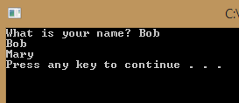
You can also change the value of a variable later in the code
name = input("What is your name? ")
print(name)
name = "Mary"
print(name)
Notes:
<number>

Slide 9
Accessing a value entered by a user
Notes:
<number>

Slide 10
What should I call them?

Slide 11
Variable names
Rules
Can not contain spaces
Are case sensitive
firstName and firstname would be two different variables
Cannot start with a number
Guidelines
Should be descriptive but not too long (favoriteSign not yourFavoriteSignInTheHoroscope)
Use a casing "scheme"
camelCasing or PascalCasing
Notes:
<number>

Slide 12
Which of the following do you think would be good names for variables?
Variable1
First Name
Date
3Name
DOB
DateOfBirth
YourFavoriteSignInTheHoroscope
Notes:
<number>

Slide 13
Learn python
Manipulating variables
WiSense Academy

Slide 14
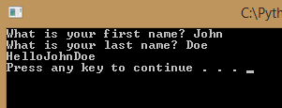
You can combine variables and strings with the + symbol
firstName = input("What is your first name? ")
lastName = input("What is your last name? " )
print("Hello" + firstName + lastName)
Notes:
<number>

Slide 15
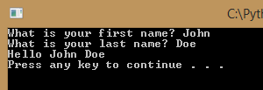
Often you need to add punctuation or spaces to format the output correctly
firstName = input("What is your first name? ")
lastName = input("What is your last name? " )
print("Hello " + firstName + " " + lastName)
Notes:
<number>

Slide 16
Formatting output
Notes:
<number>

Slide 17
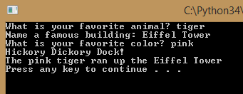
Now you can create a story teller program!
animal = input("What is your favorite animal? " )
building = input("Name a famous building: ")
color = input("What is your favorite color? ")
print("Hickory Dickory Dock!")
print("The "+color+" "+animal+" ran up the "+building)
Notes:
<number>

Slide 18
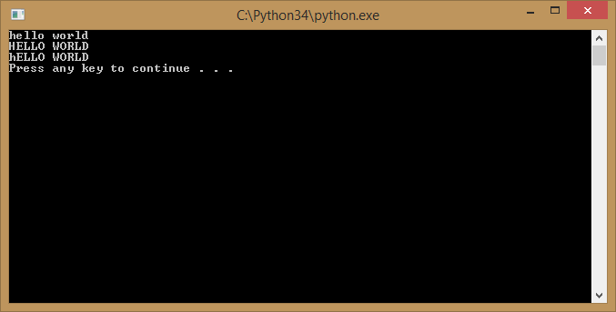
Variables also allow you to manipulate the contents of the variable
message = 'Hello world'
print(message.lower())
print(message.upper())
print(message.swapcase())
Notes:
<number>

Slide 19
Manipulating values with string functions
Learn python
Notes:
<number>

Slide 20
Geek Tip!
Lower, upper, and swapcase are different string functions
Because we are storing a string in the variable, we can use any of the Python string functions to manipulate the string
Notes:
<number>

Slide 21
Learn python
pycharm awesomeness

Slide 22
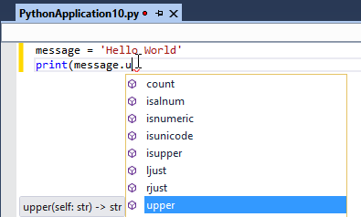
Did you notice the pop up list?
That’s IntelliSense.
pycharm will suggest possible functions that you can call automatically after you type the ‘.’
You can also use CTRL+J or CTRL+SPACE to launch IntelliSense
Notes:
<number>

Slide 23
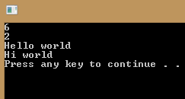
What do you think these functions will do?
message = 'Hello world'
print(message.find('world'))
print(message.count('o'))
print(message.capitalize())
print(message.replace('Hello','Hi'))
Notes:
<number>

Slide 24
Programmers do not memorize all these functions!!
So how do programmers find them when they need them?
IntelliSense
Documentation
Internet searches
Notes:
<number>

Slide 25
How could we…
Have a user enter their postal code and then display that postal code in upper case letters even if the user typed it in lowercase?
postalCode = input("Please enter your postal code: ") print(postalCode.upper())
Notes:
<number>

Slide 26
Converting to uppercase
Learn python
Notes:
<number>

Slide 27
Did you notice?
The intellisense didn’t appear to help us select the upper() function.
That’s because our program didn’t know we were going to store a string value in the postalCode variable. The upper() function is only for strings.
A good habit when coding in any language is to initialize your variables. That means when you create them you give them an initial value.
postalCode = " "
postalCode = input("Please enter your postal code: ")
print(postalCode.upper())
Notes:
<number>

Slide 28
How could we…
Ask someone for their name and then display the name someone with the first letter of their first and last name uppercase and the rest of their name lowercase?
name = " "
name = input("Please enter your name: ")
print(name.capitalize())
Notes:
<number>

Slide 29
Functions and variables allow us to make new mistakes in our code…
Each line of code below has a mistake…
message = Hello world
23message = 'Hello world'
New message = 'Hi there'
print(message.upper)
print(mesage.lower())
print(message.count())
message = 'Hello world'
23message = 'Hello world'
New message = 'Hi there'
print(message.upper())
print(message.lower())
print(message.count('H'))
Notes:
<number>

Slide 30
Your challenge
Write a program that allows a person to personalize a story
Take a page from a book or make up a story. Ask the user to enter information you can replace in the story such as their name, a place, or insert adjectives or adverbs into the story. Then display the personalized story to the user
For extra credit make sure you correct anything they type in with the incorrect case (e.g. if they type an adjective in uppercase you may want to display it in lowercase)
Notes:
<number>

Slide 31
Congratulations!
You can now write a computer program that will interact with a user
Notes:
<number>

Slide 32
WiSense Academy contact njei nicodona @FB

